Slide 1
…I urge you to live a life
worthy of the calling you
have received.
Ephesians 4:1

Slide 2
Ephesians as an epistle
Epistle = a letter
Prison epistles (~ 60 – 61 A.D.)
Ephesians Colossians
Philippians Philemon
Concentrated truth!

Slide 4
Called by God.
Ephesians 4:1 – 6

Slide 5
…I urge you to live a life worthy of the calling…
being suitable
having worth that “matches” the actual value

Slide 6
Prison epistles:
Whatever happens, conduct yourselves in a manner worthy of the gospel of Christ. Philippians 1:27
And we pray this in order that you may live a life worthy of the Lord and may please Him in every way... Colossians 1:10

Slide 7
...encouraging, comforting and urging you to live lives worthy of God, who calls you into His kingdom and glory. I Thessalonians 2:12
With this in mind, we constantly pray for you, that our God may count you worthy of His calling... II Thessalonians 1:11

Slide 8
I therefore, a prisoner for the Lord, urge you to walk in a manner worthy of the calling to which you have been called... (ESV)
Walk – an even pace; no panic or hurry
– all places in which you go
“conduct ourselves”

Slide 9
I therefore, a prisoner for the Lord, urge you to walk in a manner worthy of the calling to which you have been called... (ESV)
For He chose us in Him to be holy and blameless in His sight. 1:4
In love He predestined us to be adopted as sons
through Jesus Christ. 1:5
In Him we were also chosen…in order that
we…might be for the praise of His
glory. 1:11-12

Slide 13
I therefore, a prisoner for the Lord, urge you to walk in a manner worthy of the calling to which you have been called... (ESV)
“outward call”
“Come to me, all you who are weary and burdened, and I will give you rest.” Matthew 11:28
“If anyone is thirsty, let him come to me and drink.”
John 7:37

Slide 14
I therefore, a prisoner for the Lord, urge you to walk in a manner worthy of the calling to which you have been called... (ESV)
Man’s unwillingness and inability:
“No one can (is able to) come to me unless the Father who sent me draws him…” John 6:44
…you were dead in your transgressions and sins…
Ephesians 2:1

Slide 15
I therefore, a prisoner for the Lord, urge you to walk in a manner worthy of the calling to which you have been called... (ESV)
“inward call”
Guarantees the response on our part
But because of His great love for us, God…made us alive with Christ… Ephesians 2:4-5

Slide 16
Outward call of the gospel

Slide 17
Outward call of the gospel
Inward call (effectual call)

Slide 18
And those He predestined, He also called; those He called, He also justified; those He justified, He also glorified. Romans 8:30
God, who has called you into fellowship with His Son Jesus Christ our Lord, is faithful. I Corinthians 1:9
But when God, who set me apart from birth and called me by His grace, was pleased to reveal His Son in me... Galatians 1:15-16

Slide 19
He called you to this through our gospel, that you might share in the glory of our Lord Jesus Christ.
II Thessalonians 2:14
...who has saved us and called us to a holy life - not because of anything we have done but because of His own purpose and grace. II Timothy 1:9
But you are a chosen people, a royal priesthood, a holy nation, a people belonging to God, that you may declare the praises of Him who called you out of darkness into His wonderful light.
I Peter 2:9

Slide 21
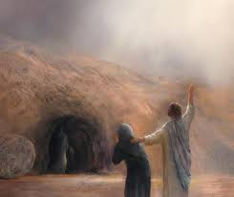
Lazarus
John 11

Slide 22
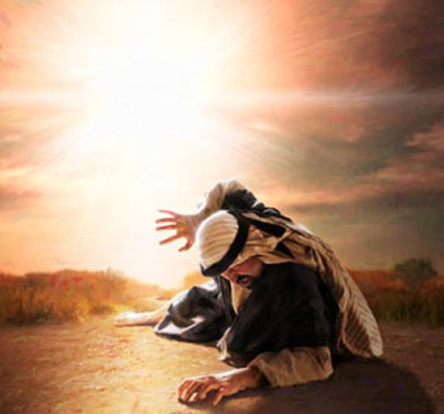
Paul
Acts 9
Galatians 1:15-16

Slide 23
Lydia
Acts 16:14

Slide 24
Outward and inward calls
Lazarus
John 11
Paul
Acts 9, Galatians 1:15-16
Lydia
Acts 16:14
You, me, others

Slide 25
It is necessary that we
share Christ with others.

Slide 26
It is necessary that we
share Christ with others.
Our ultimate trust must
be in God, who alone
gives spiritual life.
Paul planted the seed,
Apollos watered it,
but God made it grow.
I Corinthians 3:6

Slide 27
…I urge you to live a life
worthy of the calling you
have received.
Ephesians 4:1

