Slide 1
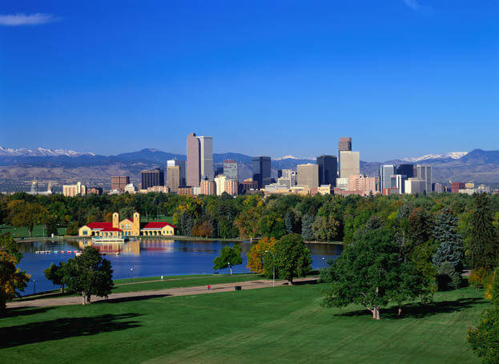
Be Imitators of God,
therefore,
as dearly loved children…
Ephesians 5:1

Slide 2
What Not to Imitate
Ephesians 5:1-7

Slide 3
Ephesians 5:3
But sexual immorality and all impurity or covetousness must not even be named among you. ESV

Slide 4
What not to imitate:
sexual immorality – “porneia” pornography
(“pornos” – one involved in porneia)
Any sexual deviancy outside of the wholesome sexual intimacy between one man and one woman in marriage
Includes: pre-marital sex
casual sex “for fun”
(Ephesians 5:25)

Slide 5
Matthew 19:4-6
"Haven't you read...that at the beginning the Creator 'made them male and female,' and said, 'For this reason a man will leave his father and mother and be united to his wife, and the two will become one flesh'? So they are no longer two, but one. Therefore what God has joined together, let man not separate."

Slide 6
What not to imitate:
impurity – “unclean” (Purity code: Leviticus 18, 20)
No one is to approach any close relative to have sexual relations. I am the Lord.
Do not dishonor your father by having sexual relations with your mother. She is your mother; do not have relations with her.
Do not have sexual relations with your father's wife; that would dishonor your father.
(Leviticus 18:6-8)

Slide 7
Everyone who does any of these detestable things - such persons must be cut off from their people. Leviticus 18:29
Do not eat any detestable thing…
Deuteronomy 14:3

Slide 8
God said all foods were now clean; he never said all sexual deviancy is now clean. Acts 10:9-16
Confusion:
Ceremonial law: Temporary – to prepare for Messiah
Moral law: Reflects God’s design in creation

Slide 9
What not to imitate:
greed – “covetousness” (idolatry)
Lusting for a greater number of temporal things that go beyond what God determines is eternally best.
Greed
vs.
Legitimate needs/wants

Slide 10
Exodus 20:17-18
You shall not covet your neighbor's house. You shall not covet your neighbor's wife, or his manservant or maidservant, his ox or donkey, or anything that belongs to your neighbor.

Slide 12
vs. 3 – sins to avoid:
sexual immorality impurity greed
vs. 5 – character of the person
immoral impure greedy
Rich man and Lazarus
Luke 16:19-31

Slide 14
Galatians 5:19-21
The acts of the sinful nature are obvious: sexual immorality (porneia), impurity and debauchery; idolatry and witchcraft; hatred, discord, jealousy, fits of rage, selfish ambition, dissensions, factions, and envy; drunkenness, orgies, and the like. I warn you, as I did before, that those who live like this will not inherit the kingdom of God.

Slide 15
I Corinthians 6:9-10
Do you not know that the wicked will not inherit the kingdom of God? Do not be deceived: Neither the sexually immoral (pornos) nor idolaters nor adulterers nor male prostitutes nor homosexual offenders nor thieves nor the greedy nor drunkards nor slanderers nor swindlers will inherit the kingdom of God.

Slide 16
Revelation 21:8
But the cowardly, the unbelieving, the vile, the murderers, the sexually immoral (pornos), those who practice magic arts, the idolaters and all liars - their place will be in the fiery lake of burning sulfur. This is the second death.

Slide 17
Wrath of God
Answered the eternal question:
“Where is the God of justice?”

Slide 18
II Thessalonians 1:6-10
God is just: He will pay back trouble to those who trouble you and give relief to you who are troubled, and to us as well. This will happen when the Lord Jesus is revealed from heaven in blazing fire with His powerful angels. He will punish those who do not know God and do not obey the gospel of our Lord Jesus. They will be punished with everlasting destruction and shut out from the presence of the Lord and from the majesty of His power on the day He comes to be glorified in His holy people and to be marveled at among all those who have believed.

Slide 19
Great and marvelous are your deeds,
Lord God Almighty.
Just and true are your ways,
King of the ages.
Revelation 15:3

Slide 20
Ways to guard our souls:
Guard your heart
Above all else guard your heart, for it is the wellspring of life. Proverbs 4:23.

Slide 21
Ways to guard our souls:
Guard your heart
Hide God’s Word in your heart
I have hidden Your word in my heart that I might not sin against you. Psalm 119:11

Slide 22
Ways to guard our souls:
Guard your heart
Hide God’s Word in your heart
Don’t put yourself in a place you can be tempted
“The Billy Graham rule”

Slide 23
Ways to guard our souls:
Guard your heart
Hide God’s Word in your heart
Don’t put yourself in a place you can be tempted
When the conversation gets seedy:
We don’t have to laugh
We can change the topic
We can quietly walk away
Let God lead!

Slide 24
Ways to guard our souls:
Guard your heart
Hide God’s Word in your heart
Don’t put yourself in a place you can be tempted
When the conversation gets seedy: Don’t be a partaker
For those married: Be careful to avoid emotional affairs

Slide 25
Ways to guard our souls:
Guard your heart
Hide God’s Word in your heart
Don’t put yourself in a place you can be tempted
When the conversation gets seedy: Don’t be a partaker
For those married: Be careful to avoid emotional affairs
Replace greed with thankfulness and contentment
But godliness with contentment is great gain…
I Timothy 6:6-7

Slide 27
To beat greed,
want the things
you already have.

Slide 28
Ways to guard our souls:
Guard your heart
Hide God’s Word in your heart
Don’t put yourself in a place you can be tempted
When the conversation gets seedy: Don’t be a partaker
For those married: Be careful to avoid emotional affairs
Replace greed with thankfulness and contentment

Slide 29
Be Imitators of God,
therefore,
as dearly loved children…
Ephesians 5:1

