Slide 1
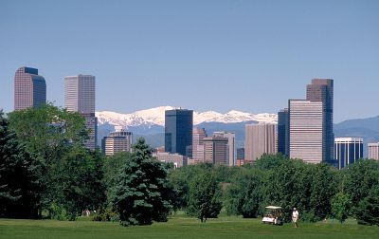
O give thanks to the Lord
for He is good;
His love endures forever.
Psalm 107:1

Slide 2
Joshua 101 –
An Orientation

Slide 3
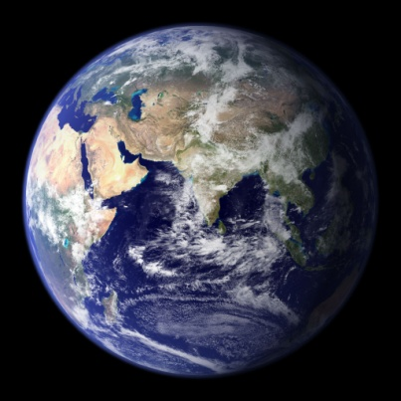
Creation
Fall
Flood
Tower of Babel – nations scattered.
Abraham ~ 2000
Egypt ~ 1846 B.C. – 1446 B.C
Enter the Promised Land ~ 1406 B.C.
David ~ 1000B.C.
Christ ~ 4 B.C.
Today! 2018 A.D.

Slide 4
Luke 24:44
This is what I told you while I was still with you: everything must be fulfilled that is written about me in the Law of Moses, the Prophets and the Psalms.

Slide 5
Law of Moses – Pentateuch “Five books”
Prophets
Former: Joshua, Judges….
Latter: Isaiah, Jeremiah…
Writings (“Psalms”): Psalms, Proverbs…

Slide 6
Joshua in the NT
Rahab - Matthew 1:5, Hebrews 11:31, James 2:25
Acts 7:45 - Having received the tabernacle, our fathers under Joshua brought it with them when they took the land from the nations God drove out before them.
Hebrews 4:8 - For if Joshua had given them rest, God would not have spoken later about another day.

Slide 7
Theme: How God fulfills His promise to Abraham in the Promised Land
So the Lord gave Israel all the land He had sworn to give their forefathers, and they took possession of it and settled there. The Lord gave them rest on every side, just as He had sworn to their forefathers. Not one of their enemies withstood them; the Lord handed all their enemies over to them. Not one of all the Lord's good promises to the house of Israel failed; every one was fulfilled.
Joshua 21:43-45

Slide 8
Who wrote Joshua?
Joshua wrote much of it.
Later editors added to it.
Samuel the final editor (?)
Complete by the time of David.

Slide 9
Joshua – a “type” of Christ
“type” – an anticipation, a foreshadowing
His name = “The Lord saves” (same as Jesus)
Joshua – physical rest; Christ – spiritual rest
“Servant of the Lord” Judges 2:8
Christ – Isaiah 42, 49, 50, 52, 53
Joshua completely followed the Lord (like Christ).
Joshua as conqueror – Christ the conqueror:
Rev 19:11-16 – “I saw heaven standing…”

Slide 10
Everything must be fulfilled that is written about me in the Law of Moses, the Prophets and the Psalms. Matthew 24:44.
For everything that was written in the past was written to teach us, so that through endurance and the encouragement of the Scriptures we might have hope. Romans 15:4
These thing happened to them as examples and were written down as warnings for us, on whom the fulfillment of the ages has come. I Corinthians 10:11
All Scripture is God-breathed, and is useful for teaching, rebuking, correcting, and training in righteousness, so that the man of God may be thoroughly equipped for every good work.
II Timothy 3:16-17

Slide 11
The book of Joshua…
Events ~ 1400 B.C.
A key transition book
Affirmed in the NT
“How God fulfills His promise to Abraham in the Promised Land”
Written by Joshua, with others
Joshua – a “type” of Christ
NT believer can find profit…

Slide 12
Genesis 15:12-21

Slide 13
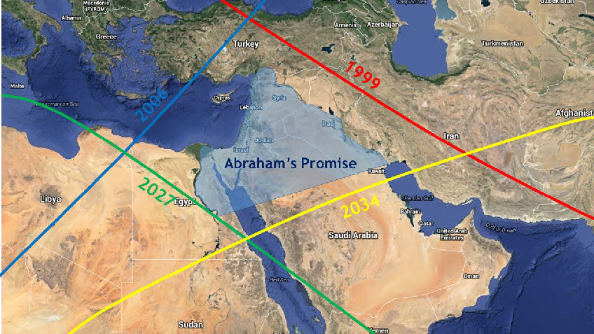

Slide 14
What was the sin of the Amorites?
Leviticus 18
vs. 24
vs. 25-28
vs. 20, 21, 23
Deuteronomy 20:16-18

Slide 15
…has not yet reached its full measure.
The patience of God!
~ 600 years = Patriarchs in the land + 400 years of slavery + 40 years in the desert

Slide 16
What the nations could have learned:
The Patriarchs didn’t serve a God made out of stone. They made altars to an unseen God (Genesis 12:8, etc.)
Abraham’s 300 fighting men (Genesis 14)
The witness of Melchizadek (Genesis 14, Hebrews 7)
Sodom and Gomorrah! (Genesis 18-19)
Abimelech encountered God in a dream (Genesis 20)
The Exodus – Rahab knew this (Judges 2)
Moral laws on human hearts (Romans 1)

Slide 17
For 600 years the nations
had ample time and opportunity
to learn about the
one true God.

Slide 18
Whistlingthewind, "The Terrible Parts of the Bible - Pt. 1" Robert Nielson, April 18, 2012
I was shocked and horrified when I found out that the Bible justifies ethnic cleansing and genocide...
However, it gets worse. See the Israelites came to the “promised land” only to find other people were living there. So God told them to drive them out and “destroy their altars, break their sacred pillars, and cut down their wooden images.” (Exodus 34:11-4) (So much for respecting other people’s religion.) This is one of the earliest examples of ethnic cleansing, of the murder of another people for the simple reason they belong to another ethnic group. And we are supposed to worship this God?

Slide 19
Whistlingthewind, "The Terrible Parts of the Bible - Pt. 1" Robert Nielson, April 18, 2012
My greatest fear is that some people might actually believe these terrible stories. Some people might believe that the genocide of another race is acceptable as the Bible condones it. Some people might use the Bible to justify hatred and violence. They might fly a plane into a tower or gun down 77 innocent people and think God approves.

Slide 20
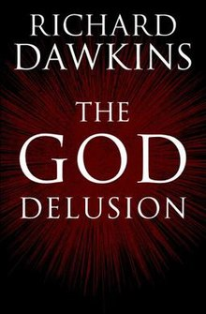
Richard Dawkins pg. 31
The God of the Old Testament is arguably the most unpleasant character in all fiction: jealous and proud of it; a petty, unjust, unforgiving control-freak; a vindictive, bloodthirsty, ethnic cleanser; a misogynistic, homophobic, racist, infanticidal, genocidal, filicidal, pestilential, megalomaniacal, sadomasochistic, capriciously malevolent bully.

Slide 22
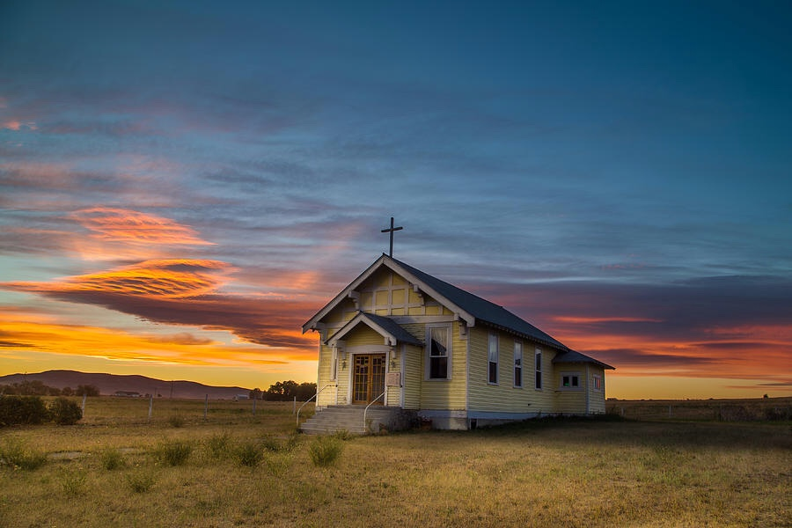

Slide 23
O give thanks to the Lord
for He is good;
His love endures forever.
Psalm 107:1

