Slide 1
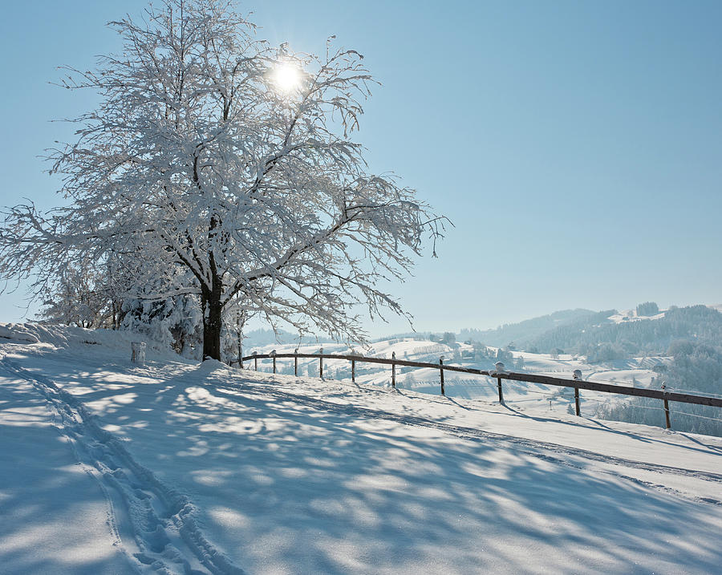
Come, let us bow down in worship,
let us kneel before the Lord
our Maker –
Psalm 95:6

Slide 2
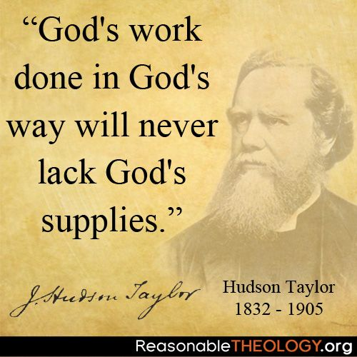

Slide 3
Today’s underlying philosophy:
Pragmatism
“Whatever works”
The end justifies the means.

Slide 4
God’s Ways
and the Battle Before Us
Joshua 5

Slide 5
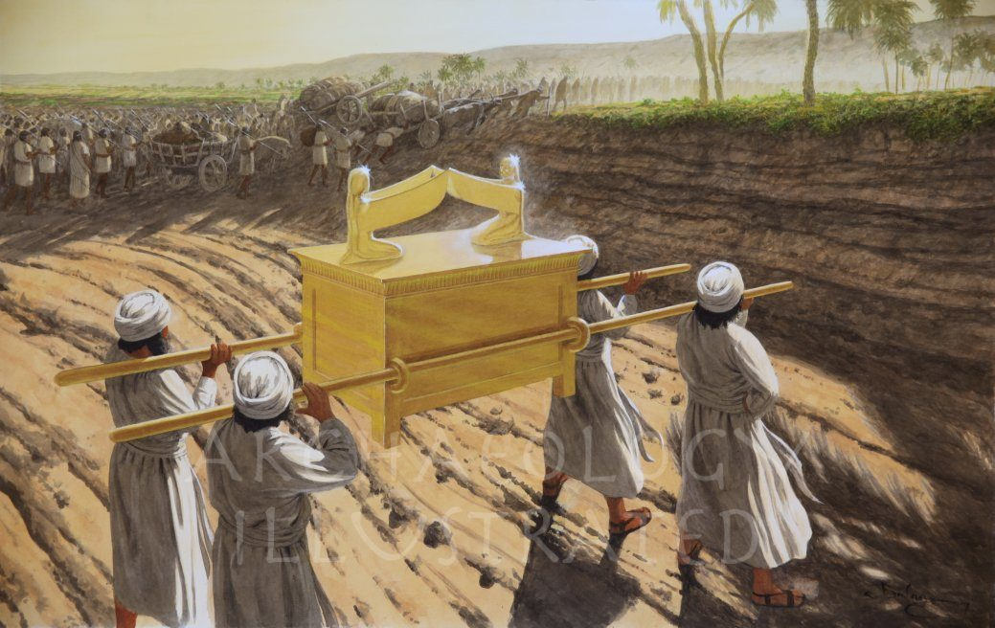

Slide 6
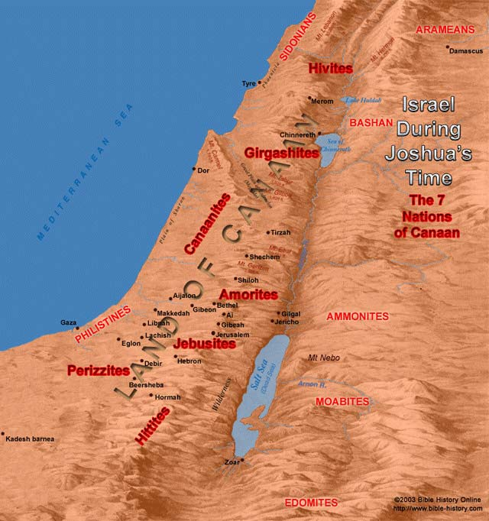

Slide 7
Genesis 17:10-11
"This is my covenant with you and your descendants after you, the covenant you are to keep: Every male among you shall be circumcised. You are to undergo circumcision, and it will be the sign of the covenant between me and you."

Slide 8
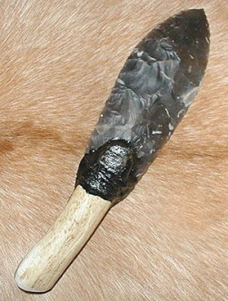
Circumcision
Foreskin surrounding the male
organ is cut off.
Why now?
Flint knife

Slide 9
12 spies sent into Canaan (Numbers 13-14)
10 spies persuaded the nation not to go in
Rebellion!
All males, 20 years and older, denied entrance.
Why no circumcision in the desert?
- No clear biblical explanation
- Maybe: They were a rebellious nation, and continued
their rebellion by not circumcising
their sons.

Slide 10
Bottom line:
Males 8 days old through (at most) 40 years old
Hundreds of thousands
Joshua must have had assistants.
Days for healing needed:
Jacob’s sons took advantage of this (Genesis 34).
Israel vulnerable!

Slide 11
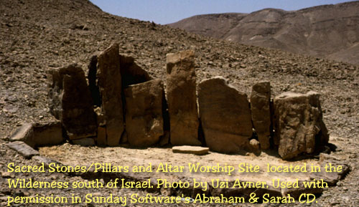
A “gilgal” –
a circle of stones
Gilgal – the reproach of
Egypt has been “rolled” away.

Slide 12
Exodus 32:11-12
"O Lord, why should your anger burn against your people, whom you brought out of Egypt with great power and a mighty hand? Why should the Egyptians say, 'It was with evil intent that he brought them out, to kill them in the mountains and to wipe them off the face of the earth?' "

Slide 13
Numbers 14:11, 15-16
"Then the Egyptians will hear about it! By your power you brought these people up from among them.... If you put these people to death all at one time, the nations who have heard this report about you will say, 'The Lord was not able to bring these people into the land he promised them on oath; so he slaughtered them in the desert.' "

Slide 14
God’s Ways
and the Battle Before Us

Slide 15
Vs. 10-12
Celebrated the Passover vs. 10
Last time – soon after Exodus (Numbers 9)
All males must be circumcised
Reminder: God’s deliverance out of Egypt
Eat the produce of the land vs. 11
Manna from heaven ends vs. 12
They are home!

Slide 16
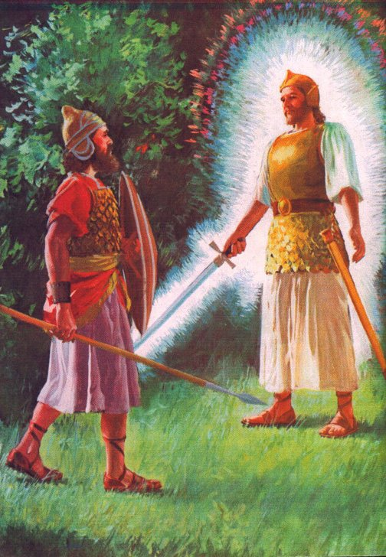
Who exactly is this?
An angel – a messenger from heaven
A theophany – YHWH Himself in bodily
form
A Christophany – preincarnate Christ
in bodily form
Many “mysterious” appearances:
Three visitors (Genesis 18-19)
The man in linen (Daniel 10)

Slide 17
Who exactly is this?
An angel – a messenger from heaven
A theophany – YHWH Himself in bodily
form
A Christophany – preincarnate Christ
in bodily form
My opinion: A theophany
Parallel to Moses at burning bush (Exodus 3)
The LORD (YHWH) speaks to Joshua (Joshua 6:2)

Slide 18
“Whose side are you on?”
Maybe: Joshua had asked the wrong
question…
“Whose side am I on?”
Will the battles be your battles,
or does the battle belong to the Lord?

Slide 19
God’s Ways
and the Battle Before Us

Slide 20
Spiritual priorities
Rightly related to God through Christ
Draw close to God “Enoch walked with God…” (Gen 5:24)
Daily being in God’s Word
Active obedience
Love: touchstone of our character
Available to share about Christ

Slide 21
Ephesians 6:12
Our struggle is not against flesh and blood, but against the rulers, against the authorities, against the powers of this dark world, and against the spiritual forces of evil in the heavenly realms.

Slide 22
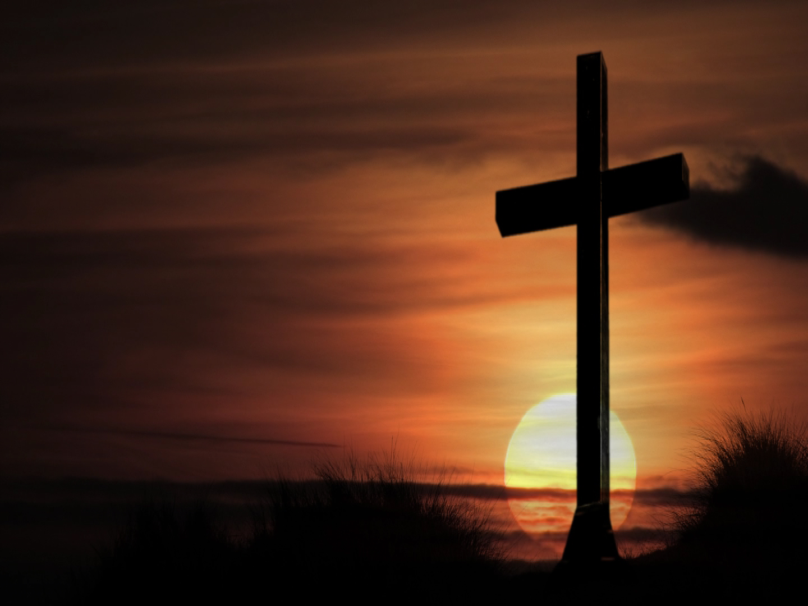
When you were dead in your sins
and in the uncircumcision of your
sinful nature, God made you alive
with Christ.
He forgave us all our sins, having
canceled the written code, with
its regulations, that was against us
and that stood opposed to us: he
took it away, nailing it to the cross.
And having disarmed the powers
and authorities, he made a public
spectacle of them, triumphing
over them by the cross.
Colossians 2:13-15

Slide 23
Come, let us bow down in worship,
let us kneel before the Lord
our Maker –
Psalm 95:6

