Slide 1
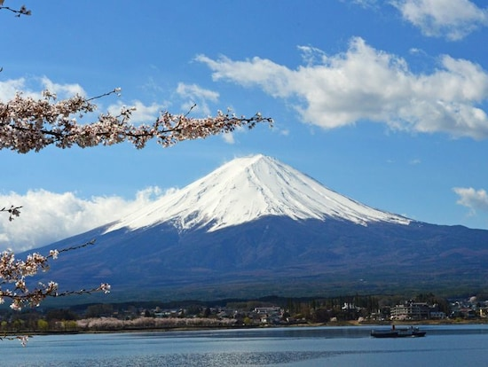
All authority has been given to me…
Therefore go and make disciples
of all nations…
Matthew 28:18-19

Slide 2
Colossians 2:6-7
So then, just as you received Christ Jesus as Lord, continue to live in Him, rooted and built up in Him, strengthened in the faith as you were taught, and overflowing with thankfulness.

Slide 3
Back on Track –
On to Ai
Joshua 8

Slide 4
Joshua
I Joshua
II Rahab
III Jordan – Ark
IV Jordan – Stones
V Circumcision
VI Jericho
VII Achan
VIII Ai

Slide 5
vs. 1-2
“Do not be afraid; do not be discouraged.”
“I have delivered into your hands…” (Joshua 6:2)
Different instructions:
“Set an ambush”
Was there more God told Joshua?
Was Joshua to use his ‘sanctified experience’?
They could take the plunder

Slide 6
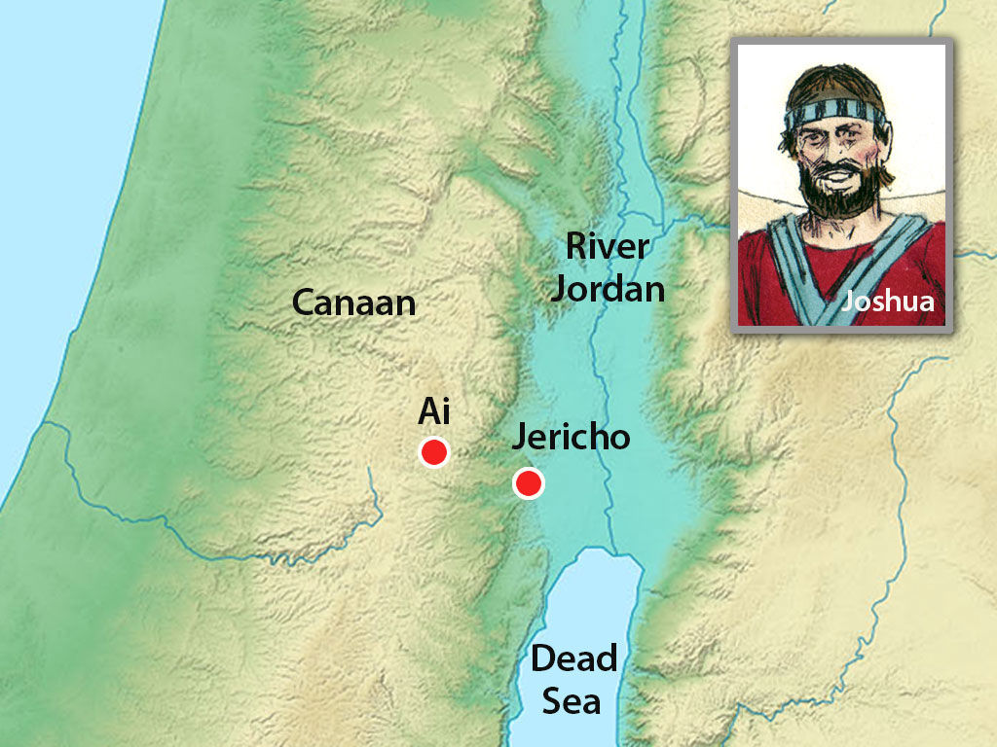
Ca. 1406 B.C.
Bethel

Slide 7
Genesis 12:6-8
Abram traveled through the land as far as the site of the great tree of Moreh at Shechem. At that time the Canaanites were in the land. The Lord appeared to Abram and said, "To your offspring I will give this land." So he built an altar there to the Lord, who had appeared to him.
From there he went on toward the hills east of Bethel and pitched his tent, with Bethel on the west and Ai on the east. There he built an altar to the Lord and called on the name of the Lord.

Slide 8
Joshua and army
Bethel
Ambush

Slide 9
vs. 3, vs. 12…?
There were 30,000, plus an additional 5,000, in ambush. Joshua had many others with him.
OR
There were 5,000 in ambush; Joshua had the remaining 25,000 with him.
Bottom line –
Everyone was where they should be!

Slide 10
Joshua and army
Bethel
Ambush

Slide 11
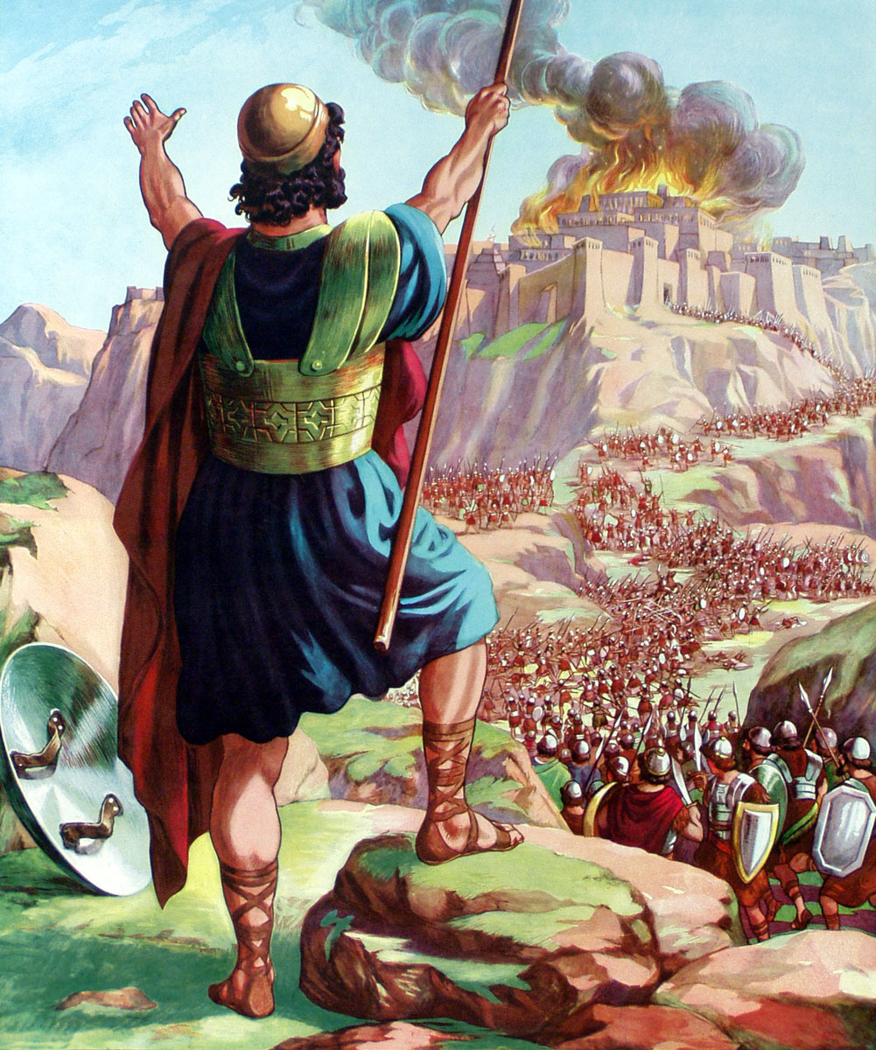

Slide 12
Israel followed through:
Every single person was put to death.
The city was burned.
Israel got to keep the livestock and plunder.
The king met his death as did the king of Jericho.
Note: Ai/Jericho most highly described
Only city with number (12,000)
The king was not crucified.
(Was impaled on a tree)

Slide 13
Deuteronomy 21:22-23
If a man guilty of a capital offense is put to death and his body is hung on a tree, you must not leave his body on the tree overnight. But sure to bury him that same day, because anyone who is hung on a tree is under God's curse. You must not desecrate the land the Lord your God is given you as an inheritance.

Slide 14
Reflections
Ai is real history

Slide 15
Reflections
It has sometimes been maintained that the God of the Old Testament was an arbitrary despot.... Such a judgement, however, is unjust and out of accord with the facts.
God, in dispossessing the Canaanites, was doing a gracious and merciful thing to the remainder of the world. The Canaanites, through their abominations, had themselves become abominations. If there was to be any salvation for the world, Canaan must go.
Edward J. Young
My Servants the Prophets
pg. 24 (1952)

Slide 16
Reflections
Ai is real history
We, too, are part of a larger mission

Slide 17
Matthew 28:18-20
Then Jesus came to them and said, “All authority in heaven and on earth has been given to me. Therefore go and make disciples of all nations, baptizing them in the name of the Father and of the Son and of the Holy Spirit, and teaching them to obey everything I have commanded you. And surely I am with you always, to the very end of the age.”

Slide 18
Make disciples
“Make sure the main thing
is the main thing.”
Dr. Charles Zimmerman
In our families
Neighbors/co-workers
State/Nation
The Nations

Slide 19
Colossians 2:6-7
So then, just as you received Christ Jesus as Lord, continue to live in Him, rooted and built up in Him, strengthened in the faith as you were taught, and overflowing with thankfulness.

Slide 20
To get back on track -
Examine yourself for any reigning sin.
No situation is outside of God’s sovereignty
There is no wisdom, no insight, no plan that can succeed against the Lord. Proverbs 21:30
God uses all circumstances in our lives
And we know that all things work together for good, to those who love God... Romans 8:28
Get up! Move out again by faith!

Slide 21
All authority has been given to me…
Therefore go and make disciples
of all nations…
Matthew 28:18-19

