Slide 1
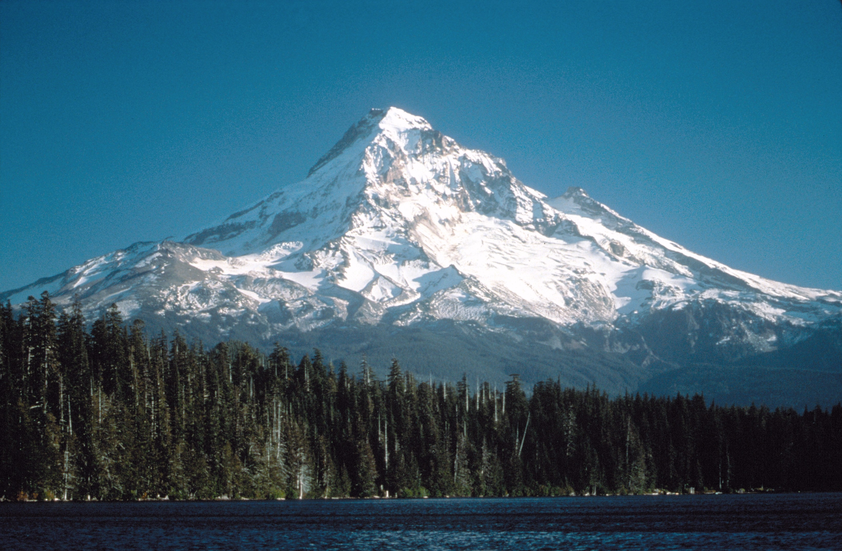
Great is the Lord
and most worthy of praise;
His greatness no one can fathom.
Psalm 145:3

Slide 2
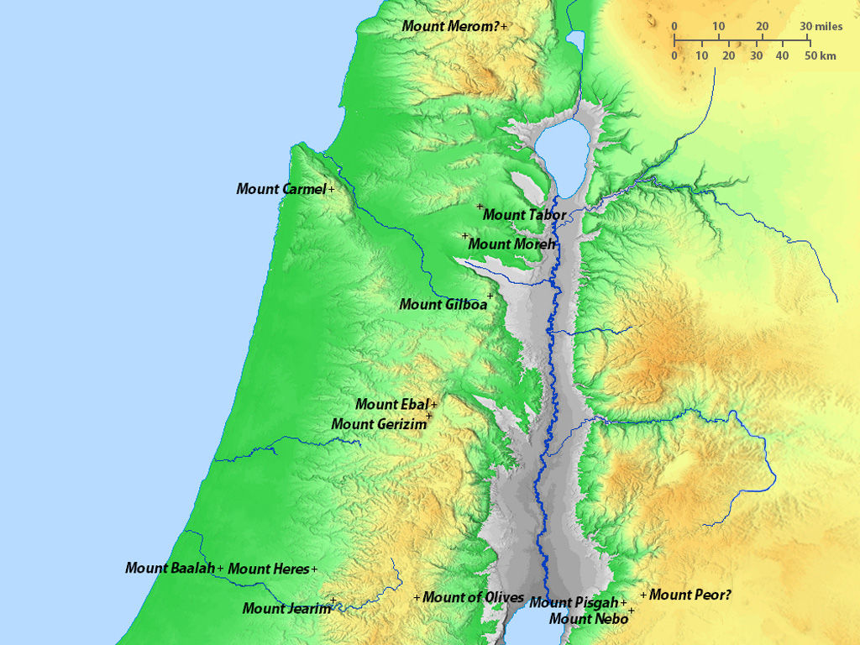
Joshua 9

Slide 3
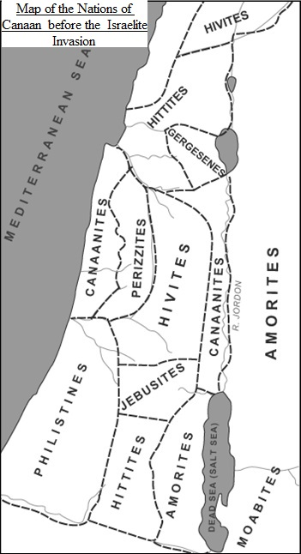

Slide 4
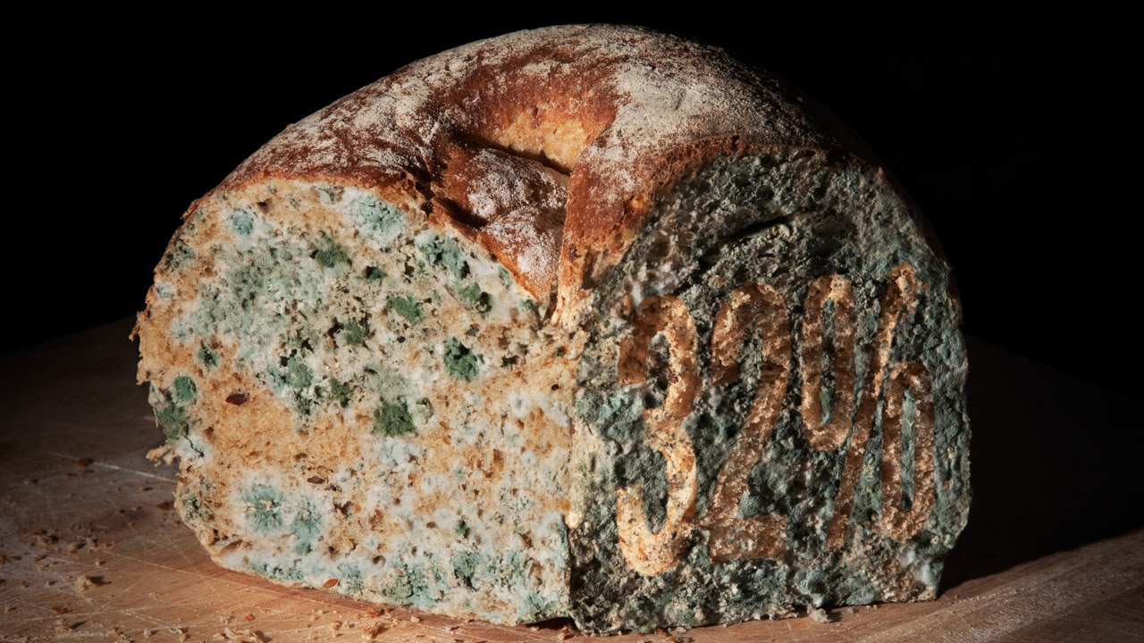

Slide 5
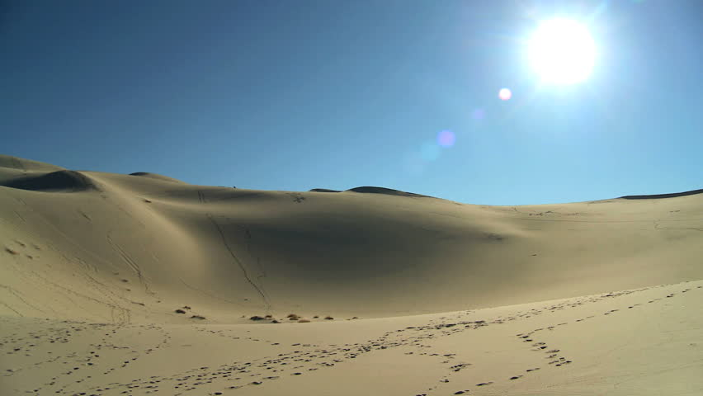

Slide 6
Deuteronomy 20
:10-15
:16-18
Joshua 9:7

Slide 7
…but did not inquire of the Lord.

Slide 8
Numbers 27:18-21
So the Lord said to Moses, "Take Joshua son of Nun, a man in whom is the spirit, and lay your hand on him. Have him stand before Eleazar the priest and the entire assembly and commission him in their presence. Give him some of your authority so the whole Israelite community will obey him.
His is to stand before Eleazar the priest, who will obtain decisions for him by inquiring of the Urim before the Lord."

Slide 11
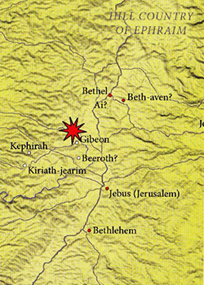

Slide 12
Psalm 84:10
I would rather be a doorkeeper in the house of my God than dwell in the tents of the wicked.

Slide 13
II Samuel 21:1
During the reign of David, there was a famine for three successive years; so David sought the face of the Lord. The Lord said, "It is on account of Saul and his blood-stained house; it is because he put the Gibeonites to death."

Slide 14
I Chronicles 12:4
...and Ishmaiah the Gibeonite, a mighty man among the Thirty, who was a leader of the Thirty.

Slide 15
I Kings 3:4-5
The king went to Gibeon to offer sacrifices, for that was the most important high place, and Solomon offered a thousand burnt offerings on that altar. At Gibeon the Lord appeared to Solomon during the night in a dream....

Slide 16
Nehemiah 3:7
Next to them repairs were made by men from Gibeon and Mizpah - Melatiah of Gibeon...

Slide 17
How can we always be inquiring of the Lord?
The whole orientation of our lives should be toward the Lord.
Seek first the Kingdom of God
and His righteousness…
Matthew 6:33

Slide 18
How can we always be inquiring of the Lord?
The whole orientation of our lives should be toward the Lord.
The primary place that we inquire of the Lord is in the Bible.
If a ruler's anger rises against you, do not leave your post; calmness can lay great errors to rest. Ecclesiastes 10:4
For we are to God the aroma of Christ…
And who is equal to such a task?
II Corinthians 2:15-16

Slide 19
How can we always be inquiring of the Lord?
The whole orientation of our lives should be toward the Lord.
The primary place that we inquire of the Lord is in the Bible.
Pray about everything!
And pray in the Spirit with all kinds of prayers and requests… Ephesians 6:18
You have not because you ask not…
James 4:2

Slide 20
How can we always be inquiring of the Lord?
The whole orientation of our lives should be toward the Lord.
The primary place that we inquire of the Lord is in the Bible.
Pray about everything!
Find out all we can – decide by faith.

Slide 21
How can we always be inquiring of the Lord?
The whole orientation of our lives should be toward the Lord.
The primary place that we inquire of the Lord is in the Bible.
Pray about everything!
Find out all we can – decide by faith.
Remember: We are disciples of Christ.
(disciple = learner)

Slide 22
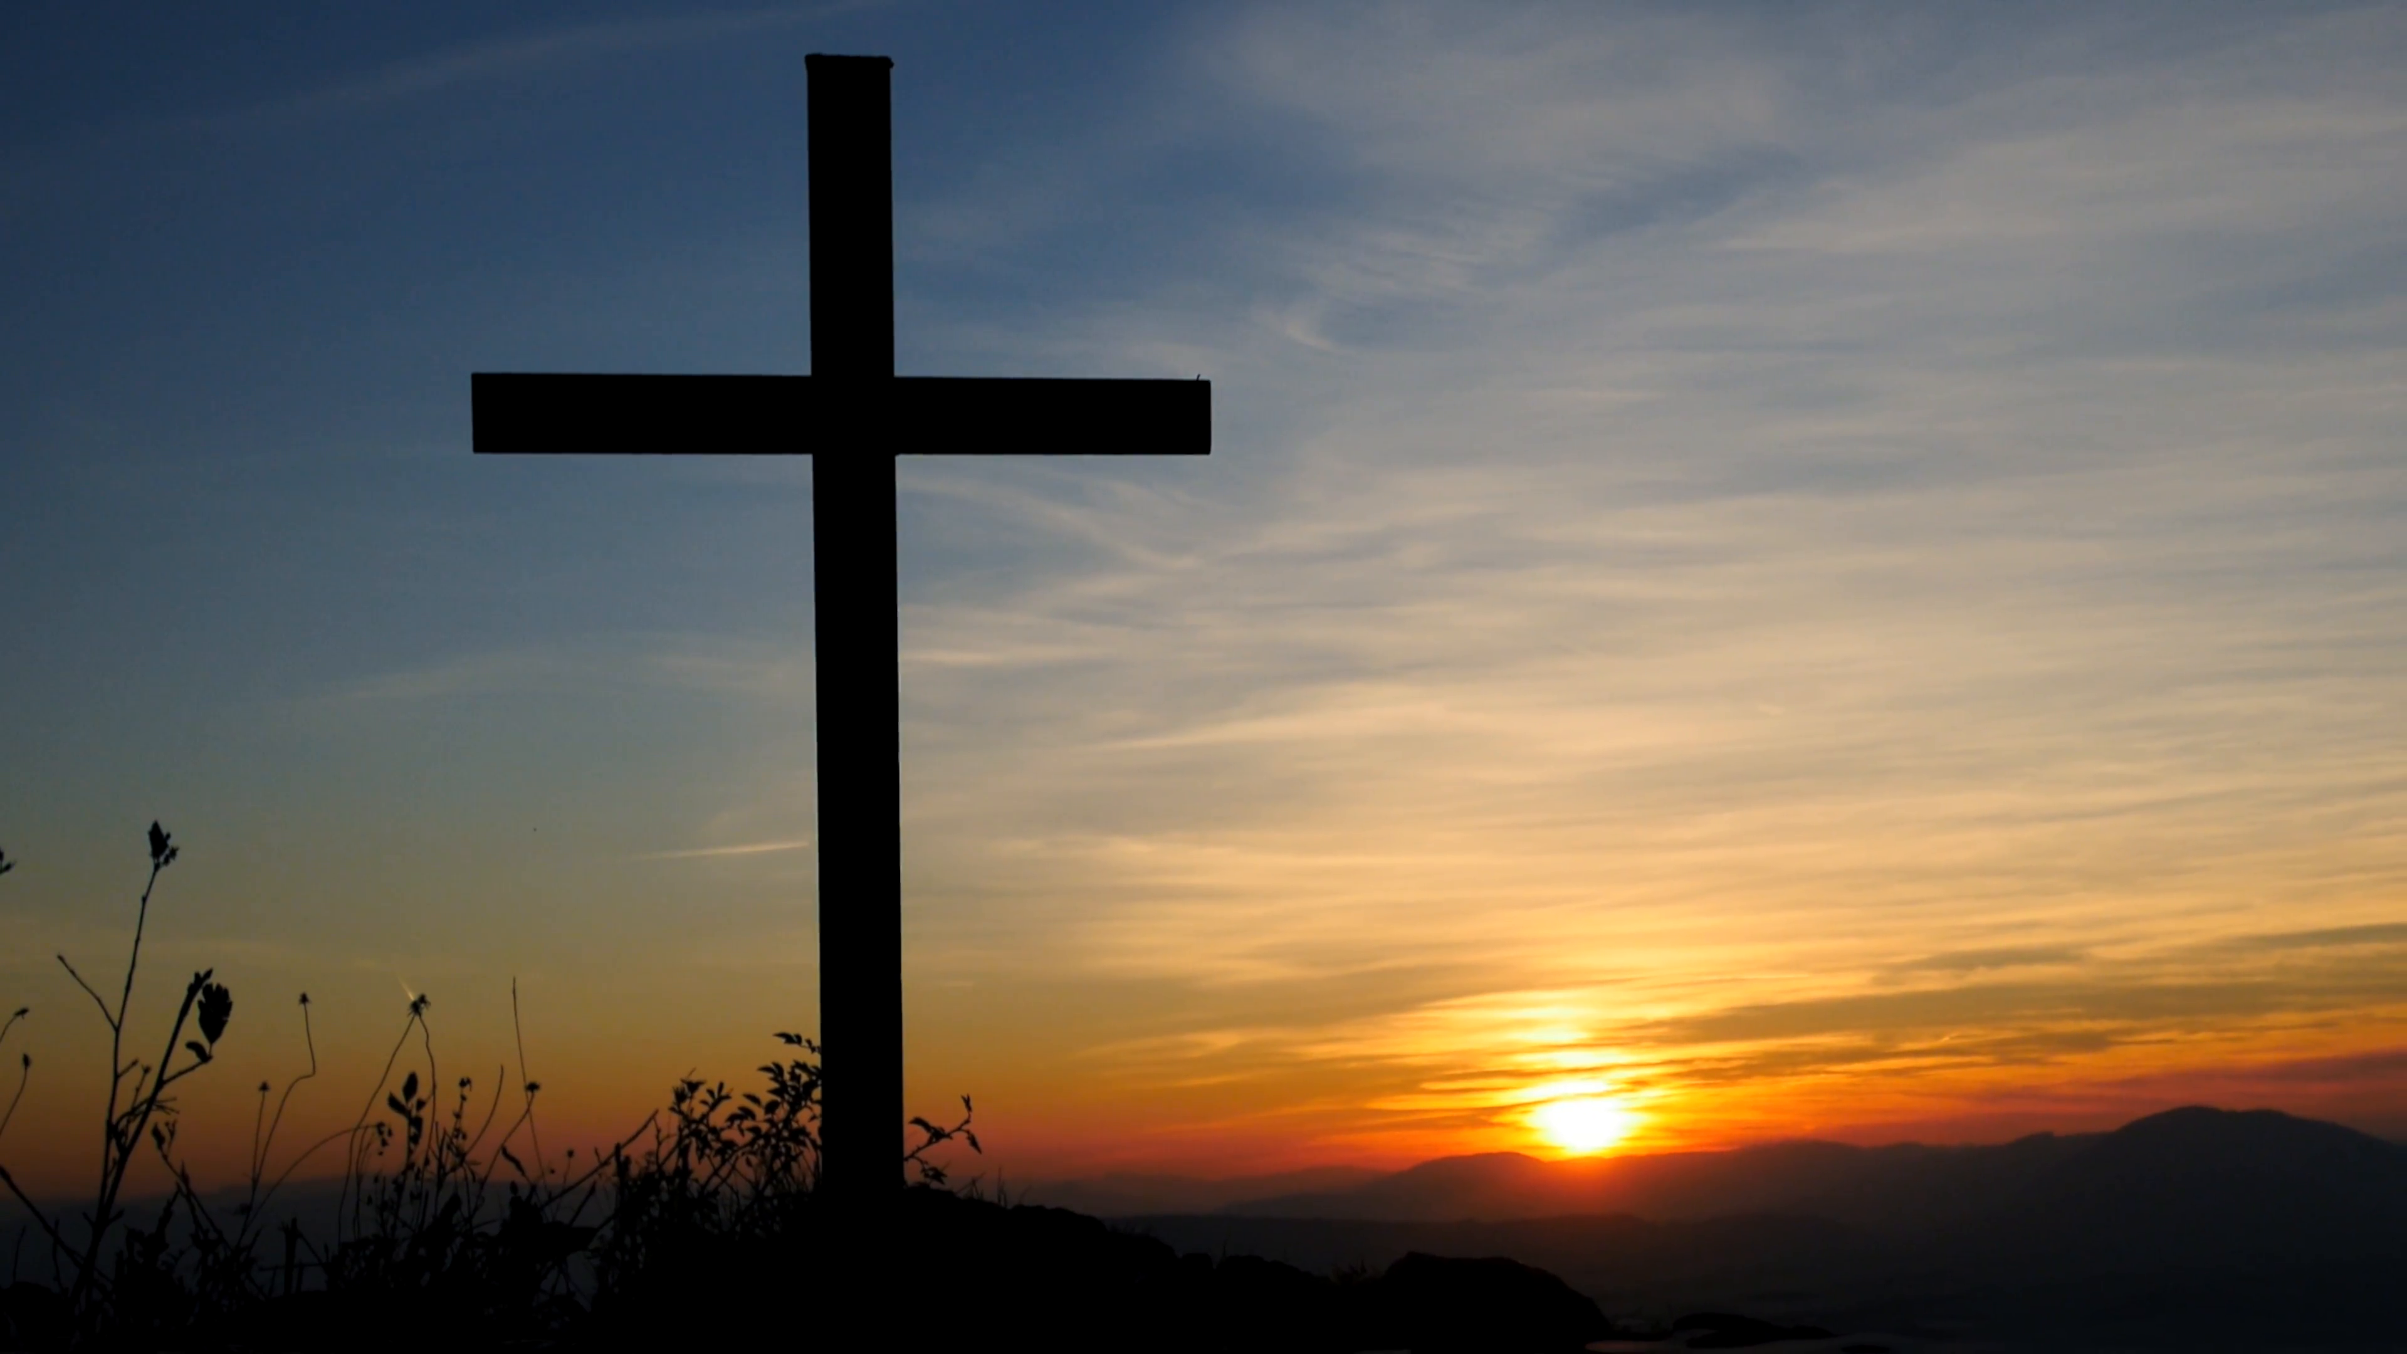
Is my life oriented toward God?
Do I look into the Bible…?
Am I bringing my requests to God?
Am I gathering good information?
Am I giving myself grace…?

Slide 23
Great is the Lord
and most worthy of praise;
His greatness no one can fathom.
Psalm 145:3

