Slide 1
You care for the land and water it;
You enrich it abundantly.
Psalm 65:9

Slide 2
Old Testament:
The New Testament in bud
New Testament:
The Old Testament in bloom

Slide 3
Psalm 44:1-3
We have heard with our ears, O God; our fathers have told us what you did in their days, in days long ago. With your hand you drove out the nations and planted our fathers; you crushed the peoples and made our fathers flourish. It was not by their sword that they won the land, nor did their arm bring them victory; it was your right hand, your arm, and the light of your face, for you loved them.

Slide 4
Joshua
The Promised Land Conquered
Chapter 1-12
The Promised Land Distributed
Chapter 13-22
The Promised Land to be Kept in Covenant
Obedience
Chapter 23-24
Martin H. Woudstra
“The Book of Joshua”

Slide 5
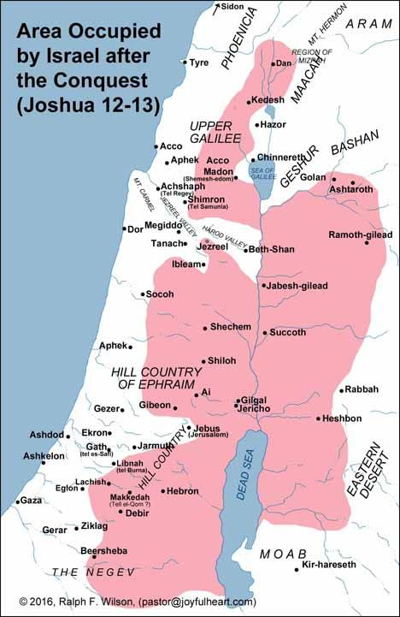

Slide 6
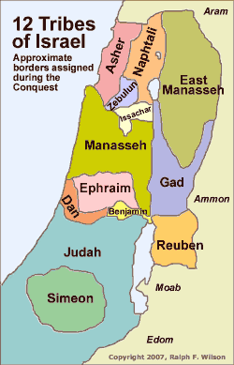
Given by Moses:
Reuben
Gad
Half tribe Manasseh
Levites - the Lord!
Towns, pasturelands
Joseph = Two tribes:
Ephraim
Manasseh
Genesis 48
Genesis 35:22 - Bilhah
I Chronicles 5:1-2

Slide 7
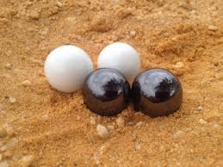
Dividing the inheritance: Casting the “lot” – Urim and Thummim
Joshua Eleazar the priest Tribal representatives

Slide 8
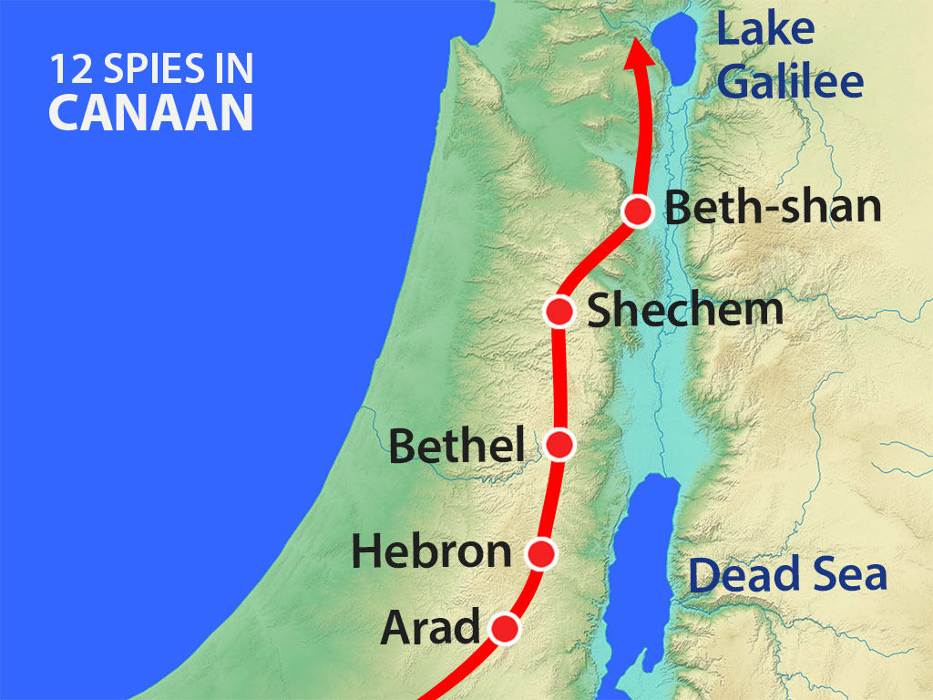

Slide 9
Numbers 14:23-24
No one who has ever treated me with contempt will see (the land). But because my servant Caleb has a different spirit and follows me wholeheartedly, I will bring him into the land he went to, and his descendants will inherit it.

Slide 10
Caleb
Now 85 years old – vigorous!
2 years in wilderness, then spies sent (40)
38 more years in wilderness (40 total)
Caleb = 78 when entering the Promised Land
After the initial Conquest = 85
The initial Conquest = 7 years!

Slide 11
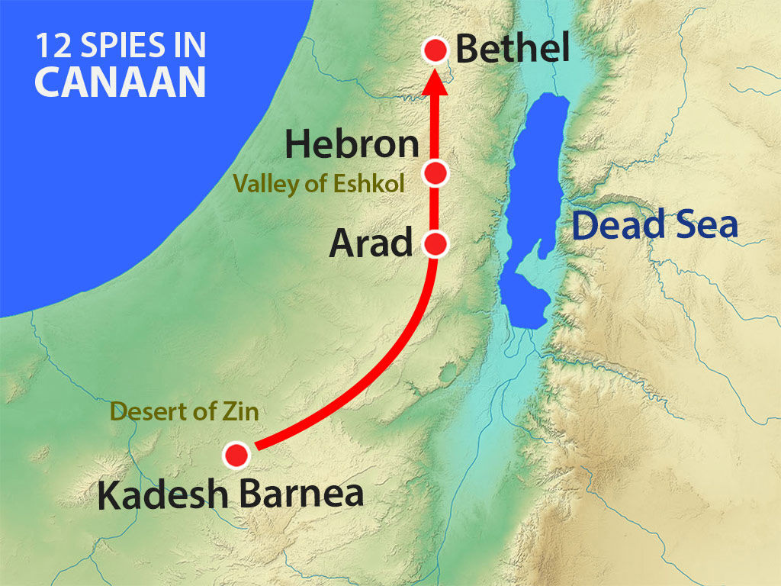

Slide 12
Why did Caleb still have to go back and take Hebron?
Joshua 10:36-37
Joshua 11:21-23

Slide 13
Why did Caleb still have to go back and take Hebron?
Joshua 10:36-37
Joshua 11:21-23
What could have happened next:
Israel returns to Gilgal (14:6)
No one is left to re-populate Hebron.
The Anakites return!
Thus, “I will drive them out.” (14:12)

Slide 15
Reflections for today
The giving of the land is one of many instances of God’s
faithfulness to His people, leading to the giving of His
Son to the world.

Slide 16
Reflections for today
The giving of the land is one of many instances of God’s
faithfulness to His people, leading to the giving of His
Son to the world.
(God) overthrew seven nations in Canaan and gave their land to His people as their inheritance. Acts 13:19
(Deuteronomy 7:1)
...God has brought to Israel the Savior
Jesus, as He promised.
Acts 13:23

Slide 17
Reflections for today
The giving of the land is one of many instances of God’s
faithfulness to His people, leading to the giving of His
Son to the world.
God’s promise of inheritance is sure.
"Now then, just as the Lord promised, He has kept me alive for forty-five years..." Joshua 14:10

Slide 18
Reflections for today
The giving of the land is one of many instances of God’s
faithfulness to His people, leading to the giving of His
Son to the world.
God’s promise of inheritance is sure.
…into an inheritance –
kept in heaven for you…
I Peter 1:4

Slide 19
Reflections for today
The giving of the land is one of many instances of God’s
faithfulness to His people, leading to the giving of His
Son to the world.
God’s promise of inheritance is sure.
How full and rich shall my inheritance be?

Slide 20
While Israel (Jacob) was living in that region, Reuben went in and slept with his father's concubine Bilhah, and Israel hear of it.
Genesis 35:22
The sons of Reuben the firstborn of Israel (he was the firstborn, but when he defiled his father's marriage bed, his rights as first-born were given to the sons of Joseph son of Israel...)
I Chronicles 5:1

Slide 22
I Corinthians 3:12-15
If any man builds on this foundation (Christ) using gold, silver, costly stones, wood, hay or straw, his work will be show for what it is, because the Day will bring it to light. It will be revealed with fire, and the fire will test the quality of each man's work. If what he has built survives, he will receive his reward. If it is burned up, he will suffer loss; he himself will be saved, but only as one escaping through the flames.

Slide 23
Reflections for today
The giving of the land is one of many instances of God’s
faithfulness to His people, leading to the giving of His
Son to the world.
God’s promise of inheritance is sure.
How full and rich shall my inheritance be?
Let’s serve the Lord wholeheartedly! (like Caleb)
“wholeheartedly” = fully

Slide 24
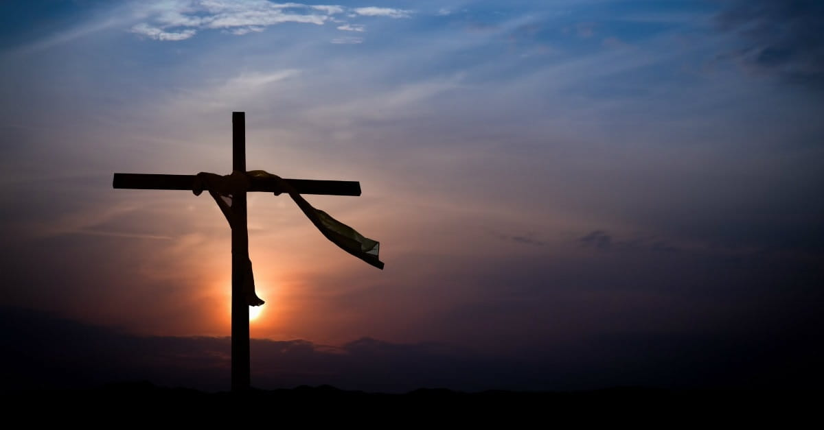
Whatever you do, work at it
with all your heart, as working
for the Lord, not for men, since
you know that you will receive
an inheritance from the Lord
as a reward.
It is the Lord Christ
you are serving.
Colossians 3:23-24

Slide 25
You care for the land and water it;
You enrich it abundantly.
Psalm 65:9

