Slide 1
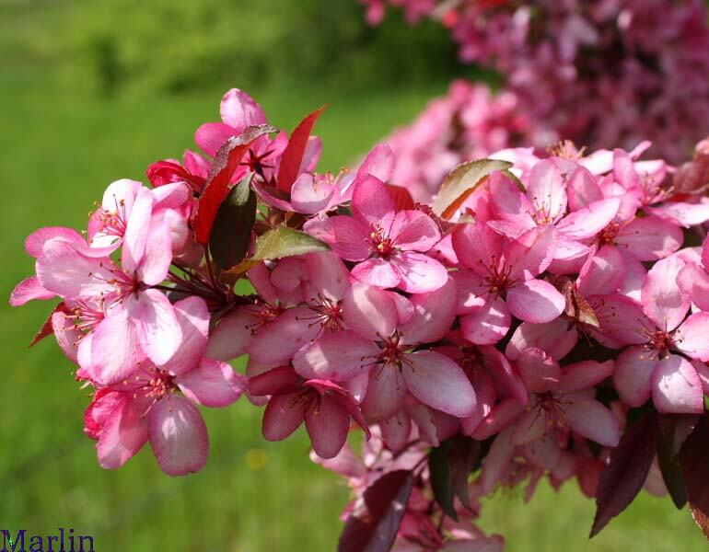
I will never leave you
nor forsake you.
Joshua 1:5

Slide 2
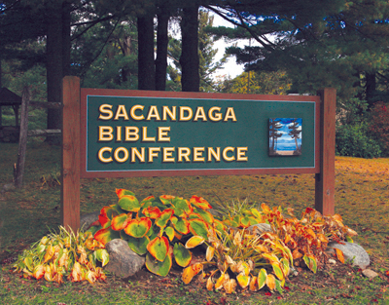

Slide 3
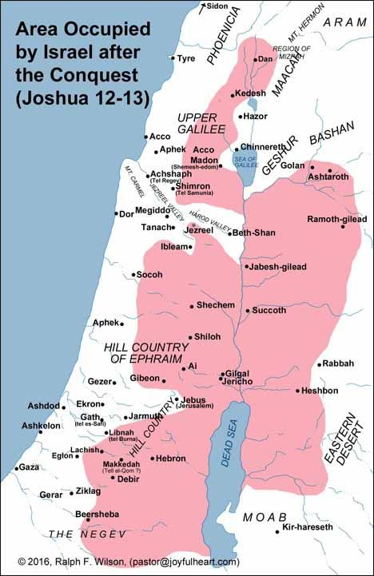

Slide 4
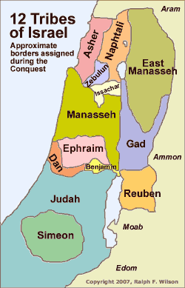

Slide 5
Joshua 15
The outer boundary of Judah vs. 1-12
Caleb, Othniel, Acsah vs. 13-19
All of the towns, geographically vs. 20 – 62
Concluding comment vs. 63

Slide 6
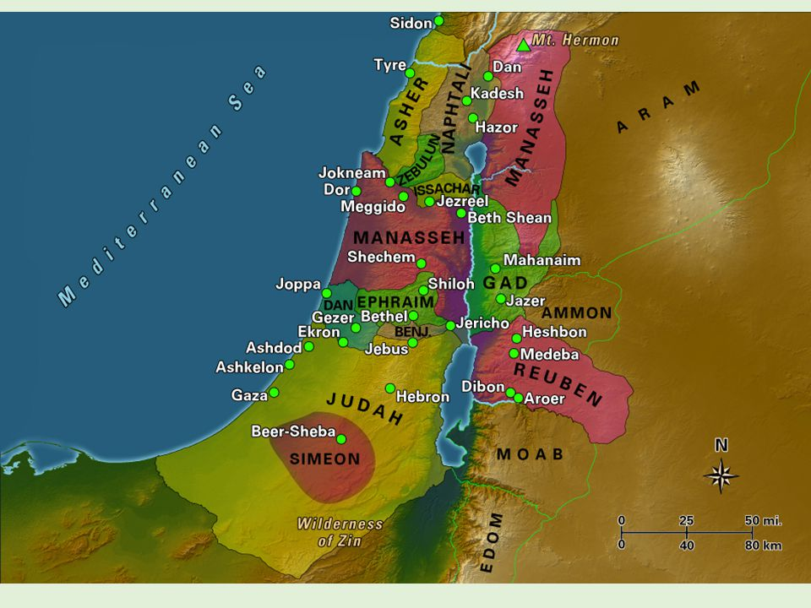

Slide 7
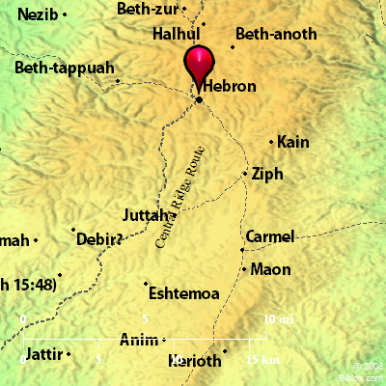

Slide 8
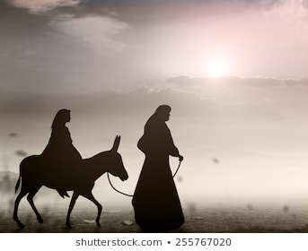

Slide 9
Judges 1:1-2
Judges 1:9-15
Judges 3:7-11

Slide 10
Caleb – son of Jephunneh 14:6
Othniel – son of Kenaz 15:17
Both brothers…
…same father?

Slide 11
Caleb – son of Jephunneh 14:6
Othniel – son of Kenaz 15:17
Both brothers…
…same father?
Caleb = 40 yrs. old when spied out the land.
No fighting men 20 or over would enter. (Num 14:29)
Othniel = Between 0 – 19 years old
Jephunneh may have died.
Caleb’s mom remarried Kenaz.
Caleb and Othniel have same mom!

Slide 12
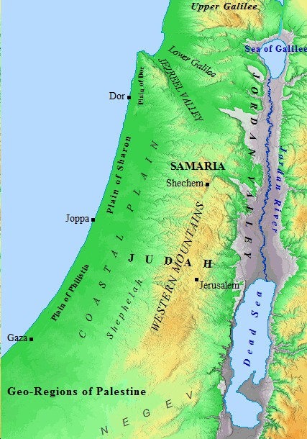
Negev
vs. 20-32
Western foothills
(Shephelah)
vs. 33-47
Hill Country
(Western Mountains)
vs. 48-60
Desert
vs.61-62
Note: vs. 45-47
Desert

Slide 13
The five key Philistine cities!
Simeon

Slide 14
Judges 1:8 Judges 1:21

Slide 15
II Samuel 5:6-7
The king and his men marched to Jerusalem to attack the Jebusites, who lived there. The Jebusites said to David, "You will not get in here; even the blind and the lame can ward you off." They thought, "David cannot get in her." Nevertheless, David captured the fortress of Zion, the City of David.

Slide 16
Joshua 15
The outer boundary of Judah vs. 1-12
Caleb, Othniel, Acsah vs. 13-19
All of the towns, geographically vs. 20 – 62
Concluding comment vs. 63

Slide 17
Caleb, Othniel and Acsah: Models of faith for us today
It is possible to have victory over sin in our lives.
They believed the promises of God:
Obey what I command you today. I will drive out before you the Amorites, Canaanites, Hittites, Perizzites, Hivites and Jebusites.
Exodus 34:11
I will give you every place you set your foot.
Joshua 1:3

Slide 18
Caleb, Othniel and Acsah: Models of faith for us today
It is possible to have victory over sin in our lives.
Not: sinless perfection
But – lives more and more in tune with God’s will.
Determine to follow the Lord whole-heartedly.
Get rid of everything that hinders…
Hebrews 12:1
“Stuffing” – takes away from God’s best

Slide 19
Caleb, Othniel and Acsah: Models of faith for us today
It is possible to have victory over sin in our lives.
Acsah – having a spirit like Caleb.
If you then, though you are evil, know how to give good gifts to your children, how much more will your Father in heaven give good gifts to those who ask Him?
Matthew 7:11

Slide 20
Caleb, Othniel and Acsah: Models of faith for us today
It is possible to have victory over sin in our lives.
Acsah – having a spirit like Caleb.
Role models in church history through today:
Jim Elliot Amy Carmichael George Mueller
Elizabeth Elliot George Whitefield Isobel Kuhn
Martin Luther Gladys Aylward Hudson Taylor
John MacArthur

Slide 21
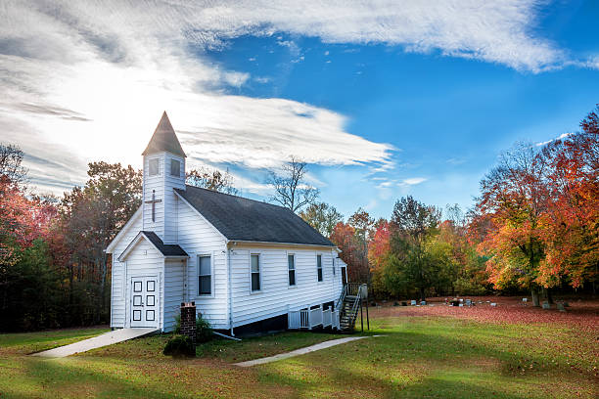
As iron sharpens iron,
so one man sharpens another.
Proverbs 27:17

Slide 22
I will never leave you
nor forsake you.
Joshua 1:5

