Slide 1
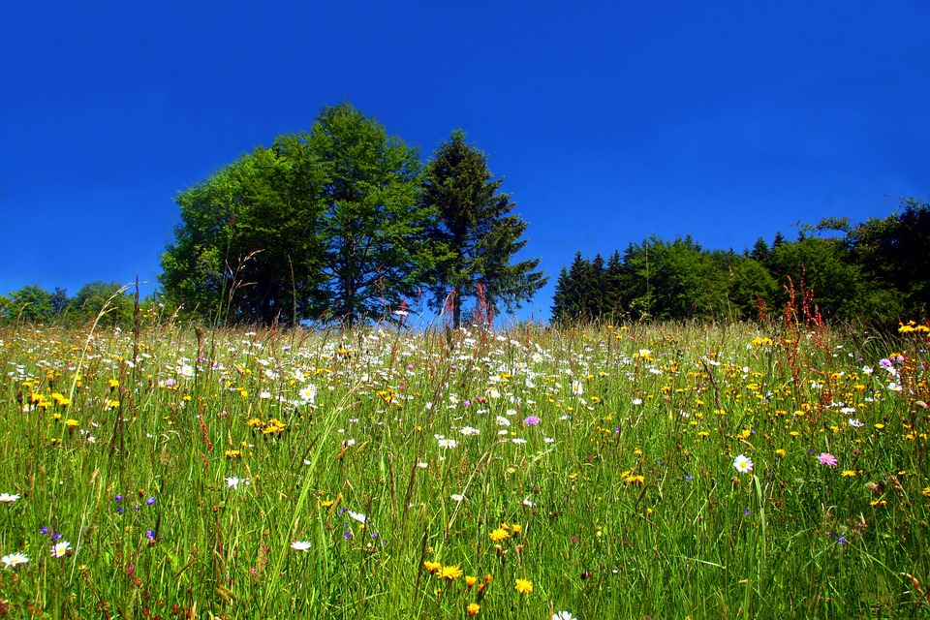
By day the Lord directs His love,
at night His song is with me –
a prayer to the God of my life.
Psalm 42:8

Slide 2
“One’s lot in life”

Slide 3
Joshua 16

Slide 4
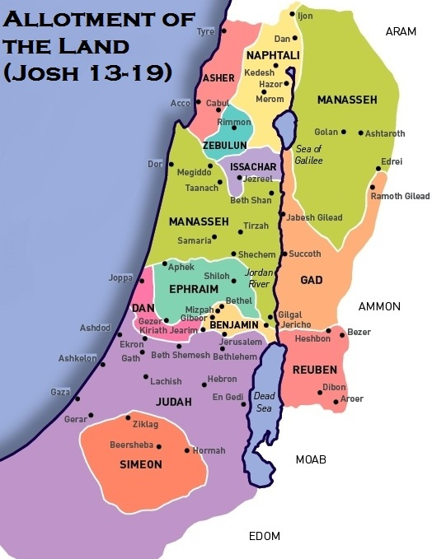

Slide 6
Judges 3:5-6
The Israelites lived among the Canaanites, Hittites, Amorites, Perizzites, Hivites and Jebusites. The took their daughters in marriage and gave their own daughters to their sons, and served their gods.

Slide 8
Numbers 27:1-8

Slide 10
Deuteronomy 7:3-4
And when the Lord your God has delivered (the nations) over to you and you have defeated them, then you must destroy them totally. Make no treaty with them, and show them no mercy....for they will turn your sons away from following me to serve other gods, and the Lord's anger will burn against you.

Slide 12
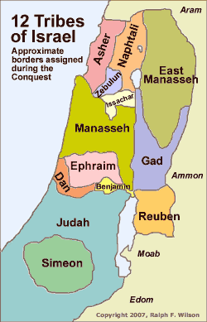
Number of fighting men
Numbers 26 census
Manasseh – 52,700
Ephraim – 40,500
Dan – 64,400
Simeon – 59,300

Slide 13
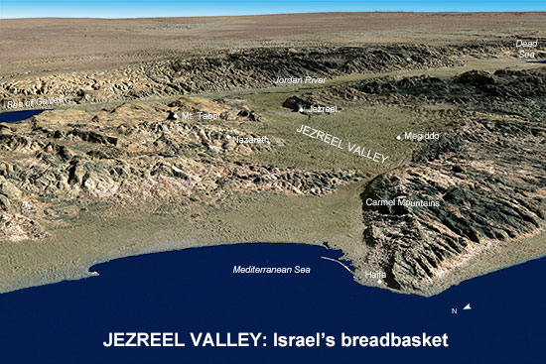
Hill country

Slide 15
Our “lot” in life today
Those sovereignly arranged details concerning our person and our life situation in which we had absolutely no say.
Year we were born Male/female
Parents Color of eyes
Country Freckles
How tall
Base personality: introvert/extrovert
thoughtful/spontaneous
mathematical/artsy
retiring/life of the party

Slide 16
Ecclesiastes 5:18-19
Then I realized that it is good and proper for a man to eat and drink, and to find satisfaction in his toilsome labor under the sun during the few days of life God has given him - for this is his lot. Moreover, when God gives any man wealth and possessions, and enables him to enjoy them, to accept his lot and be happy in his work - this is a gift of God.

Slide 17
I Timothy 6:6-7
But godliness with contentment is great gain. For we brought nothing into the world, and we can take nothing out of it.

Slide 18
Our “lot” in life today
Those sovereignly arranged details concerning our person and our life situation in which we had absolutely no say.
We must develop a certain contentment, godliness
and thankfulness.
Within our lot, we can make improvements!

Slide 19
I Corinthians 7:20-21
Each one should remain in the situation which he was in when God called him. Were you a slave when you were called? Don't let it trouble you - although if you can gain your freedom, do so.

Slide 20
Our “lot” in life today
Those sovereignly arranged details concerning our person and our life situation in which we had absolutely no say.
We must develop a certain contentment, godliness
and thankfulness.
Within our lot, we can make improvements!
To Him who is able to do immeasurably
more than all we ask or imagine.
Ephesians 3:20

Slide 21
Our “lot” in life today
Those sovereignly arranged details concerning our person and our life situation in which we had absolutely no say.
Year we were born Male/female
Parents Color of eyes
Country Freckles
How tall
Base personality: introvert/extrovert
thoughtful/spontaneous
mathematical/artsy
retiring/life of the party

Slide 22
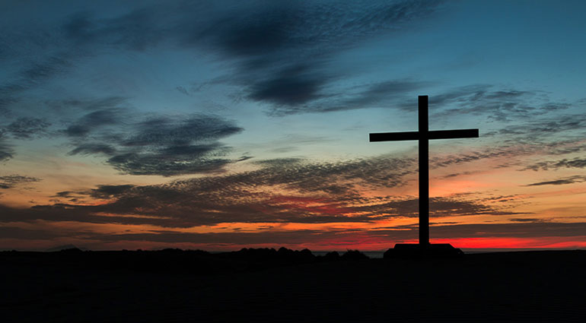

Slide 23
By day the Lord directs His love,
at night His song is with me –
a prayer to the God of my life.
Psalm 42:8

