Slide 1
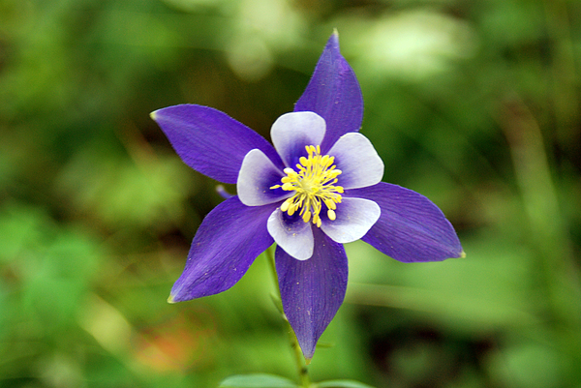
…waiting for the blessed hope –
the glorious appearing of our great
God and Savior, Jesus Christ - -
Titus 2:13

Slide 2
Last words…
Elizabeth Elliot
George Washington
Dwight D. Eisenhower
Jesus Christ: John 14-17
Our own senior saint…
Joshua!

Slide 3
Joshua 23
Key things the next generation
needs to take to heart
How shall we today carry on
the mission of God in a
godly way?

Slide 4
Joshua 23
Remember what God has done:
He has fought for them. vs. 3
Raining hailstones Joshua 10:11
He allotted the land (through Joshua). vs. 4
Remember what God will do: vs. 5
Will continue to drive out
the nations.

Slide 5
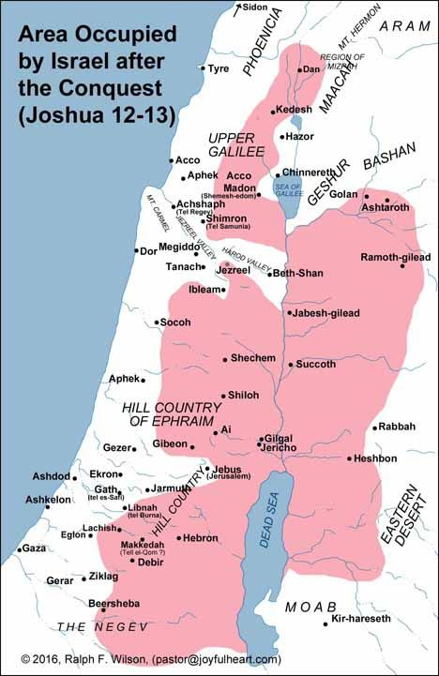
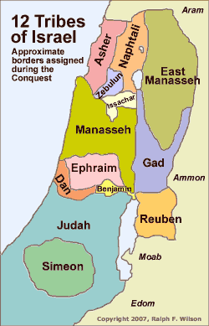

Slide 6
Joshua 23
Be strong! vs. 6 “Be strong and courageous” (Josh. 1:6-9)

Slide 7
Joshua 23
Be strong! vs. 6 “Be strong and courageous” (Josh. 1:6-9)
Be careful to obey all that is written… vs. 6 (Josh. 1:7-8)

Slide 8
Joshua 23
Be strong! vs. 6 “Be strong and courageous” (Josh. 1:6-9)
Be careful to obey all that is written… vs. 6 (Josh. 1:7-8)
Do not associate with these nations! vs. 7
Don’t invoke the names of their gods
Don’t swear by their gods No idolatry!
Don’t serve… Don’t bow down…

Slide 9
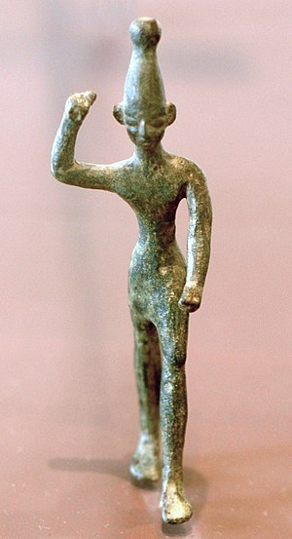
Bronze idol: Baal
(1400’s B.C.)

Slide 10
Joshua 23
Be strong! vs. 6 “Be strong and courageous” (Josh. 1:6-9)
Be careful to obey all that is written… vs. 6 (Josh. 1:7-8)
Do not associate with these nations! vs. 7
Don’t invoke the names of their gods
Don’t swear by their gods No idolatry!
Don’t serve… Don’t bow down…
Hold fast to the Lord your God. vs. 8
Joshua 22:5

Slide 11
Joshua 23
(vs. 9-11)
Remember what God has done!
Therefore…
…be careful to love the Lord your God.
(like a letter from Paul)
Ephesians

Slide 12
Change of tone
(vs. 12-13)
A severe warning!
Rewards/punishments:
Leviticus 27
Deuteronomy 28

Slide 13
Change of tone
(vs. 12-13)
A severe warning!
“Unless you repent, you too will all perish.” Luke 13:5
But the cowardly, the unbelieving, the vile, the murderers, the sexually immoral, those who practice magic arts, the idolaters, and all liars - their place will be in the fiery lake of burning sulfur. This is the second death.
Revelation 21:8

Slide 14
If you violate the covenant… vs. 16
covenant = an agreement between two or more
persons
God with man:
Conditional covenant – promises based on obedience.
Blessings conditioned on man’s response.
Unconditional covenant – no conditions on man’s part for
God to fulfill His promises.
To Noah – no universal flood!
To David – One who reigns forever!

Slide 15
If you violate the covenant… vs. 16
covenant = an agreement between two or more
persons
God with man:
Conditional covenant – promises based on obedience.
Blessings conditioned on man’s response.
Israel in the Promised Land…
as long as they remain
faithful to God.

Slide 16
Joshua’s farewell
Remember -
What God has done in the past.
What He will do in the future!
Therefore –
Be strong
Obey all that is written
Avoid idolatry
Hold fast to God
Be careful to love Him
You will remain, only as you are faithful.

Slide 17
How shall we today carry on the mission of God in a godly way?
Our mission: The Great Commission –
Go and make disciples of all nations… Matthew 28:19
And this gospel of the kingdom will be preached in the whole world as a testimony to all nations, and then the end will come. Matthew 24:14
Six ways to reach God’s world (omf.org/us/6-ways/)
Learn. Send.
Pray. Welcome.
Go. Mobilize.

Slide 18
Our mission: The Great Commission –
Remember! (at Communion)
What God has done in the past – Christ on the cross
What God will do in the future – Christ’s return in glory

Slide 19
Our mission: The Great Commission –
Remember!
Therefore:
Hold fast to God
Draw near to God
and He will draw near to you.
James 4:8

Slide 20
Our mission: The Great Commission –
Remember!
Therefore:
Hold fast to God
Don’t conform to the culture
Don’t conform any longer to the pattern of this world….
Romans 12:2
Pattern of our culture: wealth, fame, show,
security, health, long life, “anything goes”

Slide 21
Our mission: The Great Commission –
Remember!
Therefore:
Hold fast to God
Don’t conform to the culture
Be careful to do all that is written in the Book of the Law
(our Bibles – God’s final revelation)

Slide 22
Navigators -
Hear: Sunday mornings, tapes, CDs, radio broadcasts
Read: Devotions; 5 sections - History, Psalms, Proverbs,
Prophets, NT
Study: Commentary, Biblehub.com, Gotquestions.org,
Memorize: A verse that speaks to what you are going through
Meditating: Until a verse becomes sweet to our souls

Slide 23
Our mission: The Great Commission –
Remember!
Therefore:
Hold fast to God
Don’t conform to the culture
Be careful to do all that is written in the Book of the Law
Disciple others around us:
Be friendly!
Share – testimony
what God means to you
what Christ has done
…as much as they will listen!
Build up in the faith

Slide 24
II Timothy 2:2
And the things you have heard me say in the presence of many witnesses entrust to reliable men who will also be qualified to teach others.

Slide 25
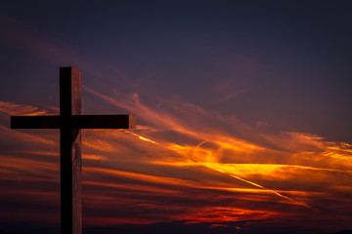

Slide 26
…waiting for the blessed hope –
the glorious appearing of our great
God and Savior, Jesus Christ - -
Titus 2:13

